Slide 1

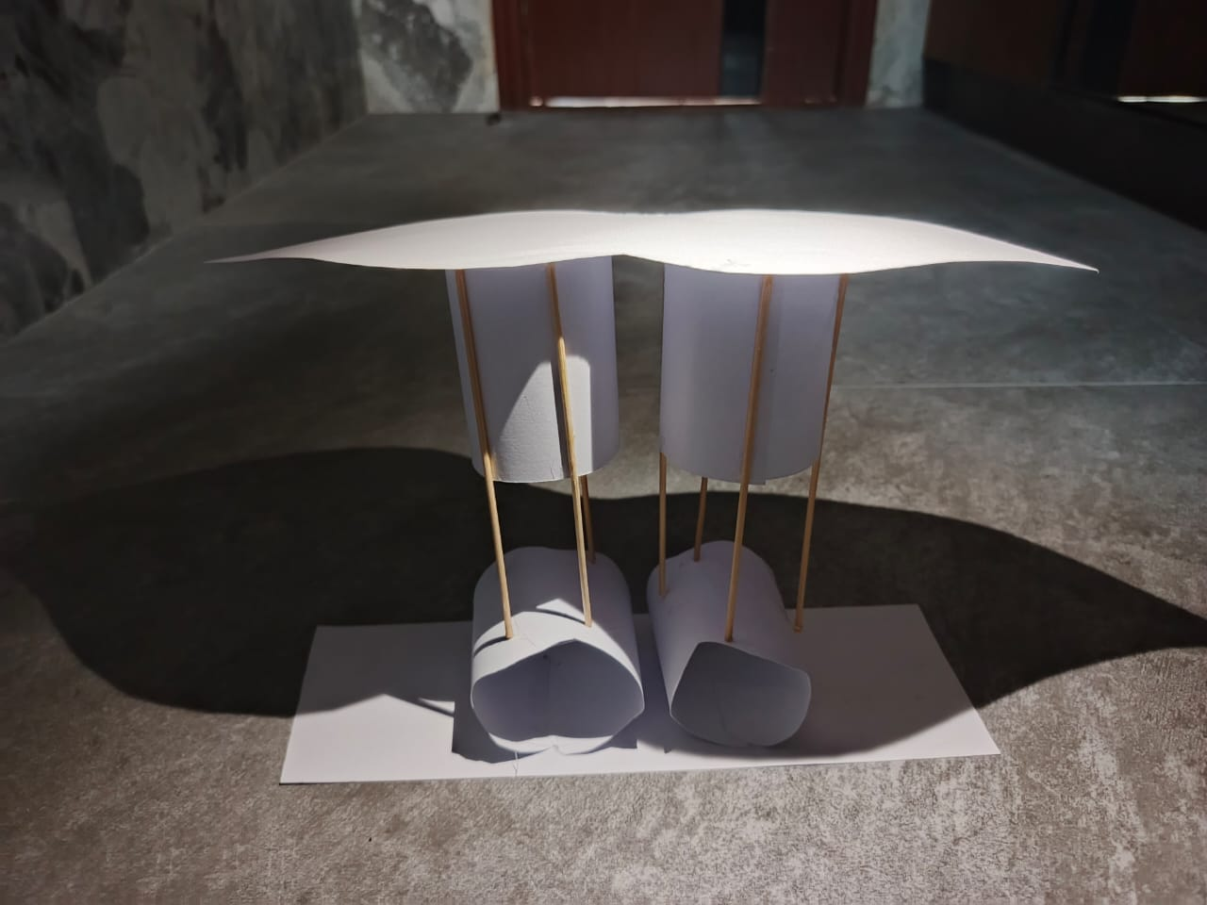
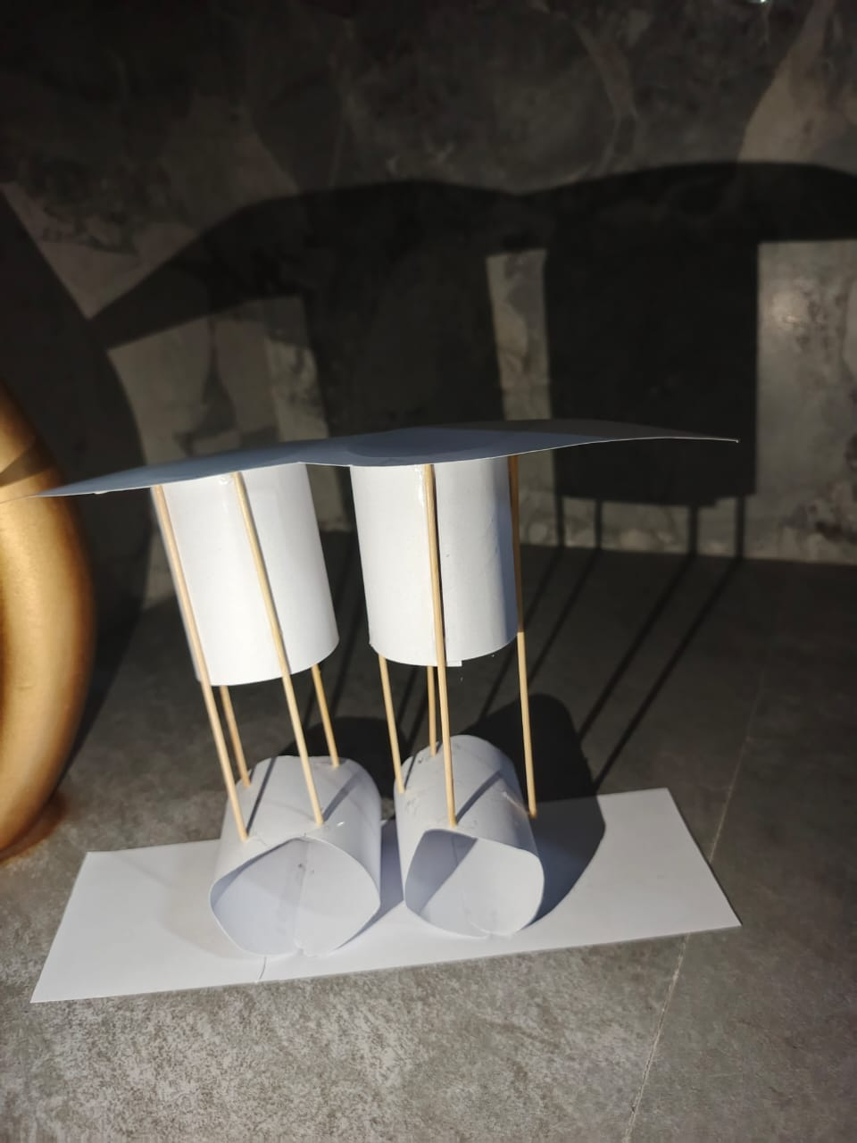
Lights and shadows
It is the important element that shape how a space looks , feels and functions. It gives us a natural vibe.

